Slide 1
Boiler Blow down use case Updated [22nd Dec 2021]

Slide 2
Boiler optimization analysis - Outcomes
SCOPE : Analyze & Optimize the Boiler Blow Down Rate by measuring Near Real-time quality parameters from Feed water, Drum water and Steam & optimize the chemical dosages as per SOP to improve the Boiler efficiency
Outcomes: Optimizing Chemical Strokes [Continuous and batch] at right time with right Qty of chemical dosage to control the optimized CBD/IBD for Boiler efficiency
Deriving quality parameters from Operation & Conductivity parameters [feed-water, drum water & Steam]
Appropriate Chemical Strokes & Blow-down recommendation with Qty - Batch & Realtime

Slide 3
Data Availability & Scope
Available Data
Expected Data
Day Wise Data : Water flow rate, At-temperature water flow, blow-down%, Fuel consumption, Steam temp & Pressure, Chemical dosage consumption
Shift-wise Data : Manual quality measures at feed water, Drum water and Steam
Minute Wise Data : Conductivity Sensor Data at feed water, DM and Steam
Shift-wise Data : Chemical Dosage consumed by continuous flow scheduled at Feed water [Morpholine, DEHA] & TSP at Drum Water
Shift-wise data preparation and availability would increase the accuracy of outcome analysis
Adding conductivity data would add the accuracy of prediction – quality measures

Slide 4
Boiler Process
DEHA
Cont. Chemical Addition
Morpholine
Batch - Chemical Strokes
TSP
8Hr quality Data for Dosage & Blow down Control
Optimization point / Control Operators
Feed – pH, Silica, R-DEHA& Silica
DM – pH, Phosphates & Silica
Quality parameters
Steam - Silica
Feed Water/90% recycle
Turbine
Steam
Feed Water
Drum Water
Steam Drum
Boiler
Makeup Water 10%
Gas Combustion
Cont. Blow Down
Intermittent Blow Down
Wastage
Water Re-cycle

Slide 5
Boiler optimization analysis – Scope & Outcomes
Blow Down optimization Scope[Feed water, Drum Water & Steam] | Input Parameters | Expected Outcomes | Challenges | Approach
Dosage Qty optimization @Feed water. Compute Accessing Feed water quality data [pH, Conductivity, DEHA & Silica] at Near real time to decide the Chemical Stroke with right optimized proportion | Batch : pH, Conductivity, DEHA & Silica Real-time : Conductivity | Triggering Optimized Chemical Stroke in Near real-time | No real-time quality data except the Conductivity No historical chemical stroke transaction with Qty | Deriving near-real time quality data using sensor provided real-time conductivity – Designing Soft Sensors using Algos
Dosage Qty optimization @Drum Water. Basing on Conductivity measure , compute other quality parameters [pH, Conductivity, Silica & Phosphate] & provide the Chemical Stroke with right optimized proportion along with possible increase in CBD or initiation of IBD | Batch : pH, Conductivity, Silica & Phosphate Real-time : Conductivity | Triggering Optimized Chemical Stroke & CBD/IBD in Near real-time | No real-time quality data except the Conductivity No historical chemical stroke transaction with Qty | Deriving near-real time quality data using sensor provided real-time conductivity – Designing Soft Sensors using Algos
Dosage Qty optimization @Steam. Basing on Conductivity measure, compute other quality parameter [silica] & provide the possible increase in CBD or the initiation of IBD | Batch: Silica Real-time : Conductivity | Triggering Optimized CBD/IBD in Near real-time | No real-time quality data except the Conductivity | Deriving near-real time quality data using sensor provided real-time conductivity – Designing Soft Sensors using Algos

Slide 6
List of Tasks
Data Preparation.
EDA – Uni & Bi Variate Analysis.
Interpretation.
Quality parameters has gone out of the threshold.
Predict the Quality Parameters for Feed Water - pH, Silica.
Predict the Quality Parameters for Drum Water - Silica, PO4.
Predict the Quality Parameters for main stream - Silica.
Model Building.

Slide 7
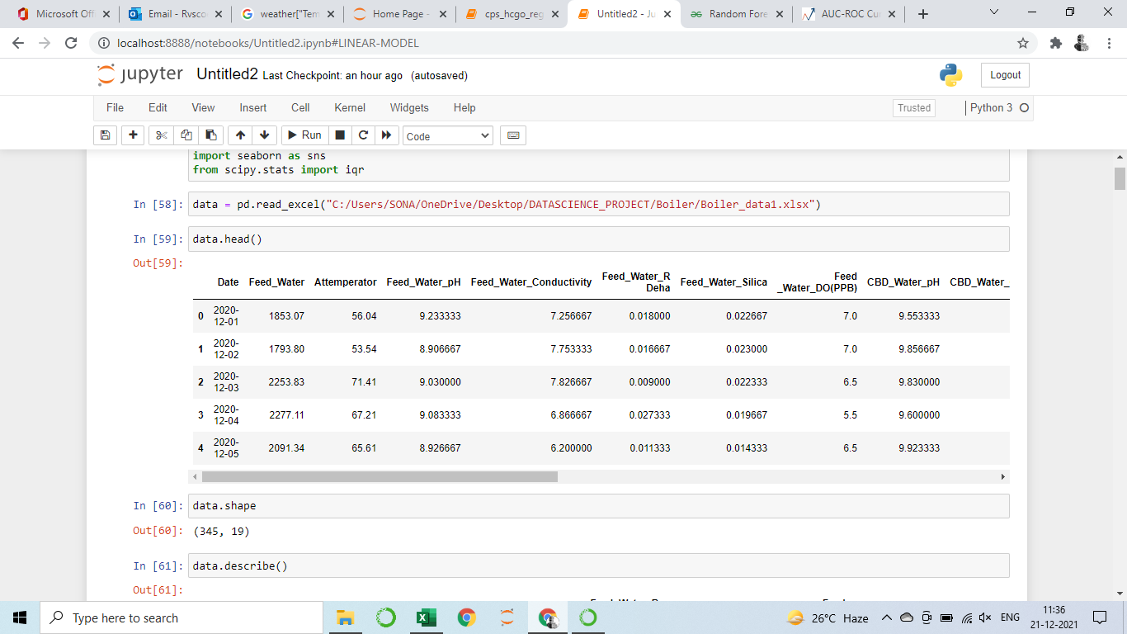
Final Dataset
Integrated all the data set with the time-line of day wise
Removed the IBR Shutdown rows in the given dataset.

Slide 8
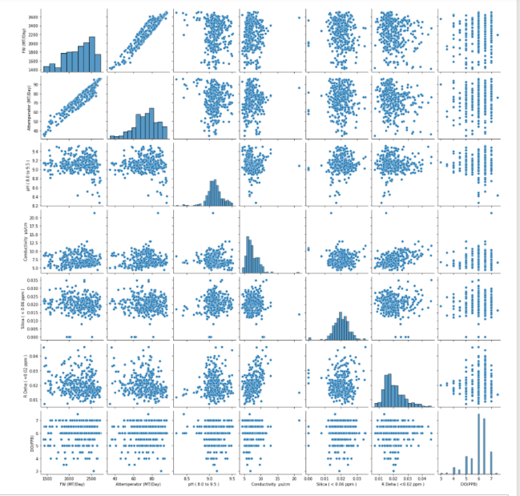
Feed Water EDA – Bi Variate Analysis
Feed water and Attemperator feed are in positive correlation
Increase in conductivity will decrease the pH value in feed water

Slide 9
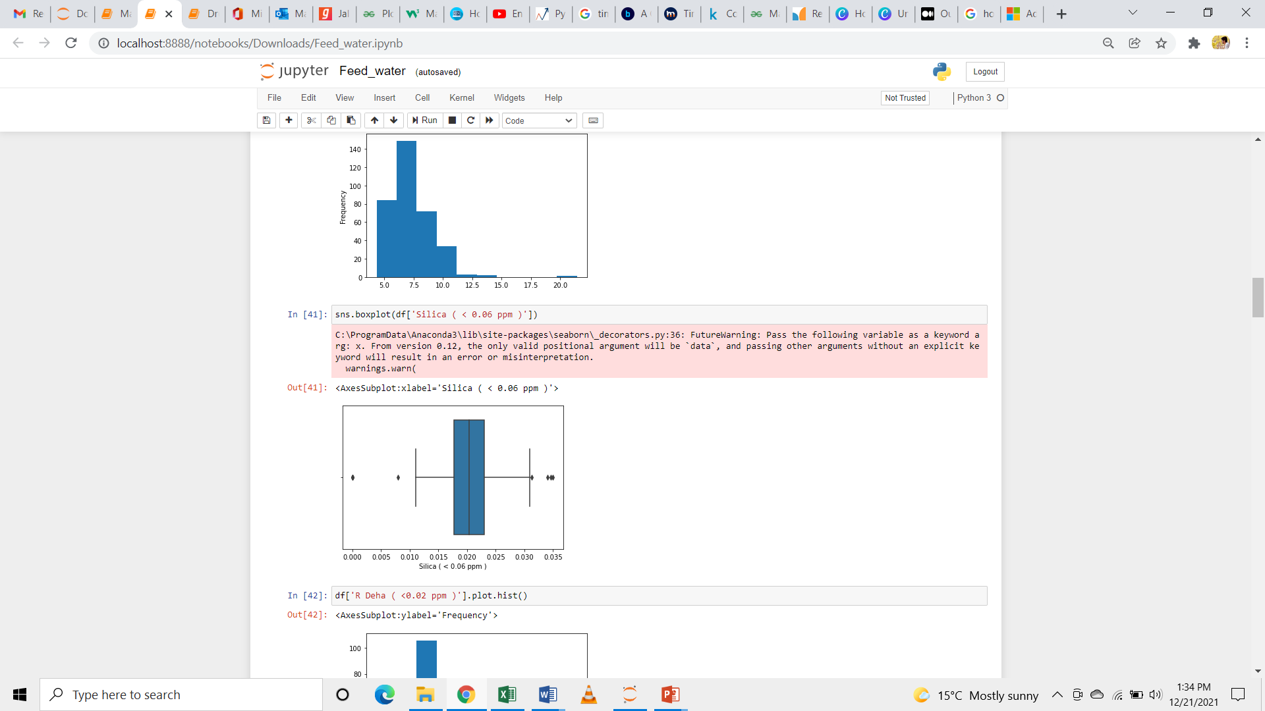
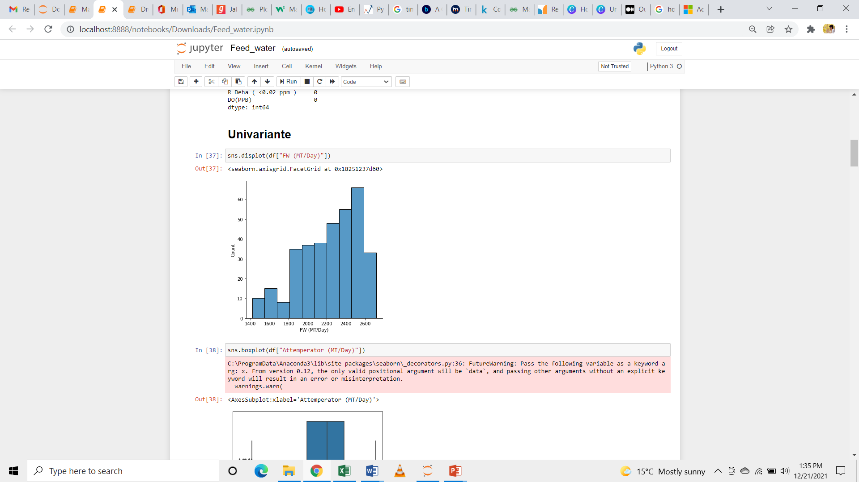
Feed Water EDA – Uni Variate Analysis.
No variance of Silica level in Feed water – Mostly consistent
Silica level is in increasing trend from Feed water, DM and Steam

Slide 10
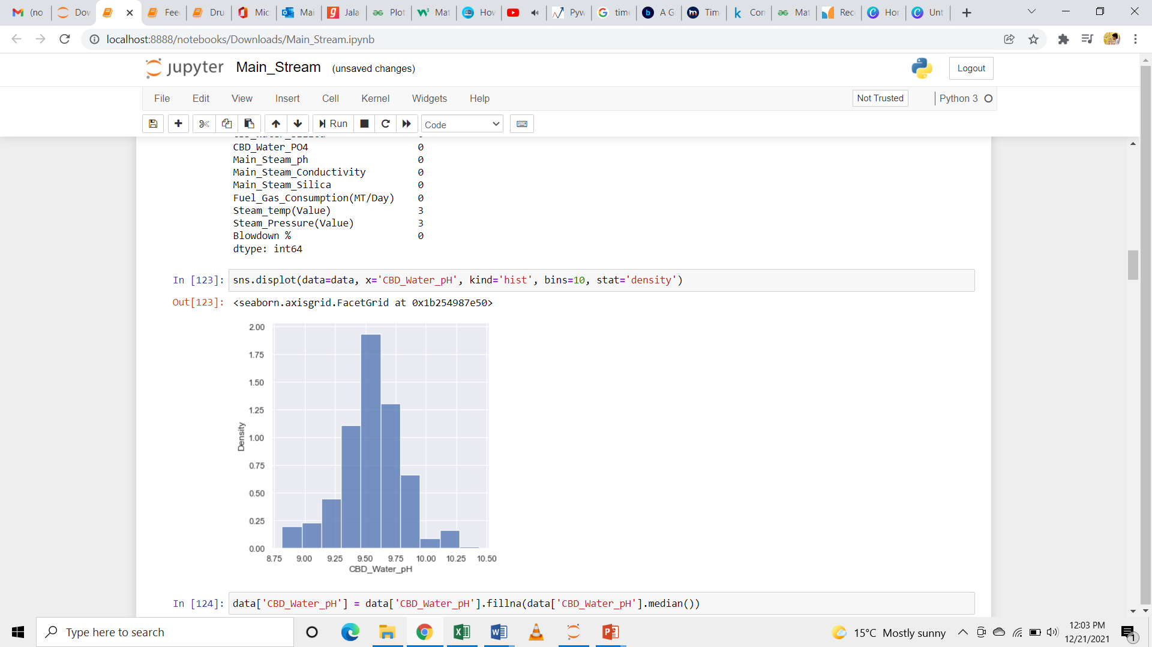
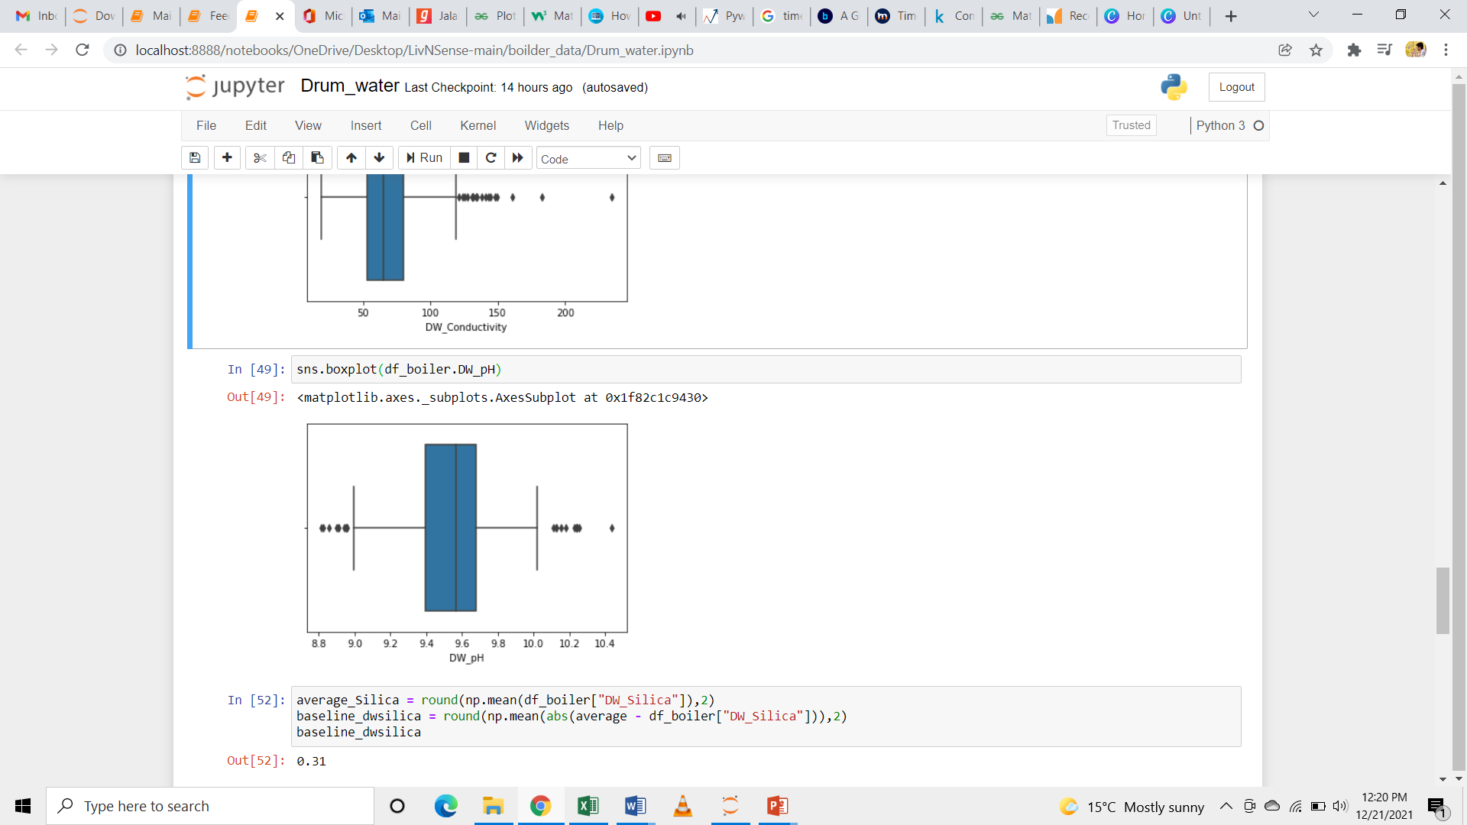
Drum Water EDA – Uni Variate Analysis
NA value is being replaced with median.
In Drum Water pH there are many outliers in the dataset.
Lower range is 8.55
Upper range is 10.11

Slide 11
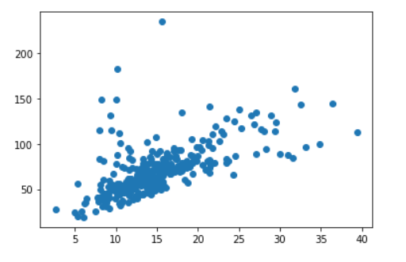
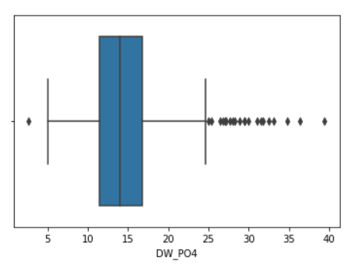
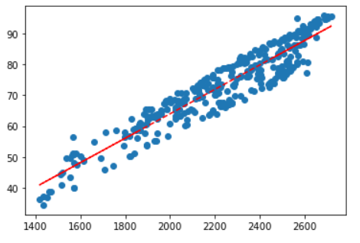
Drum Water EDA – Bi Variate Analysis.
Feed water increase & Attemperator Feed water are directly proportionate. In value of correlation can take any values from -1 to 1.
Feed water and Attemperator variable are positively correlated.
In Drum Water PO4 there are many outliers in the dataset – PO4 in high variations, Lower_range is 3.11 & Upper_range is 24.79

Slide 12
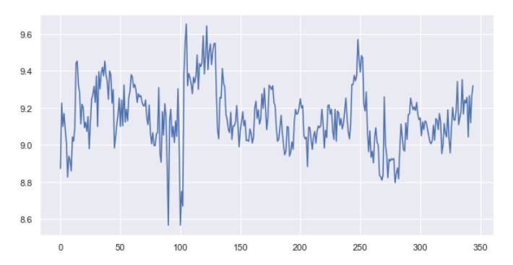
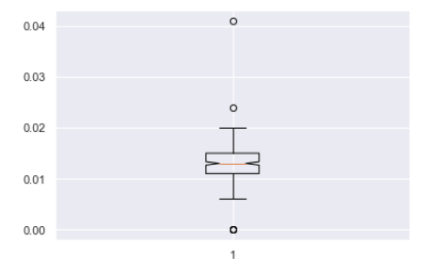
Main Steam EDA – Uni Variate Analysis.
Silica levels are varying in Steam [0.01 to 0.04].
Main stream pH is increase based on the feed water pH value.

Slide 13
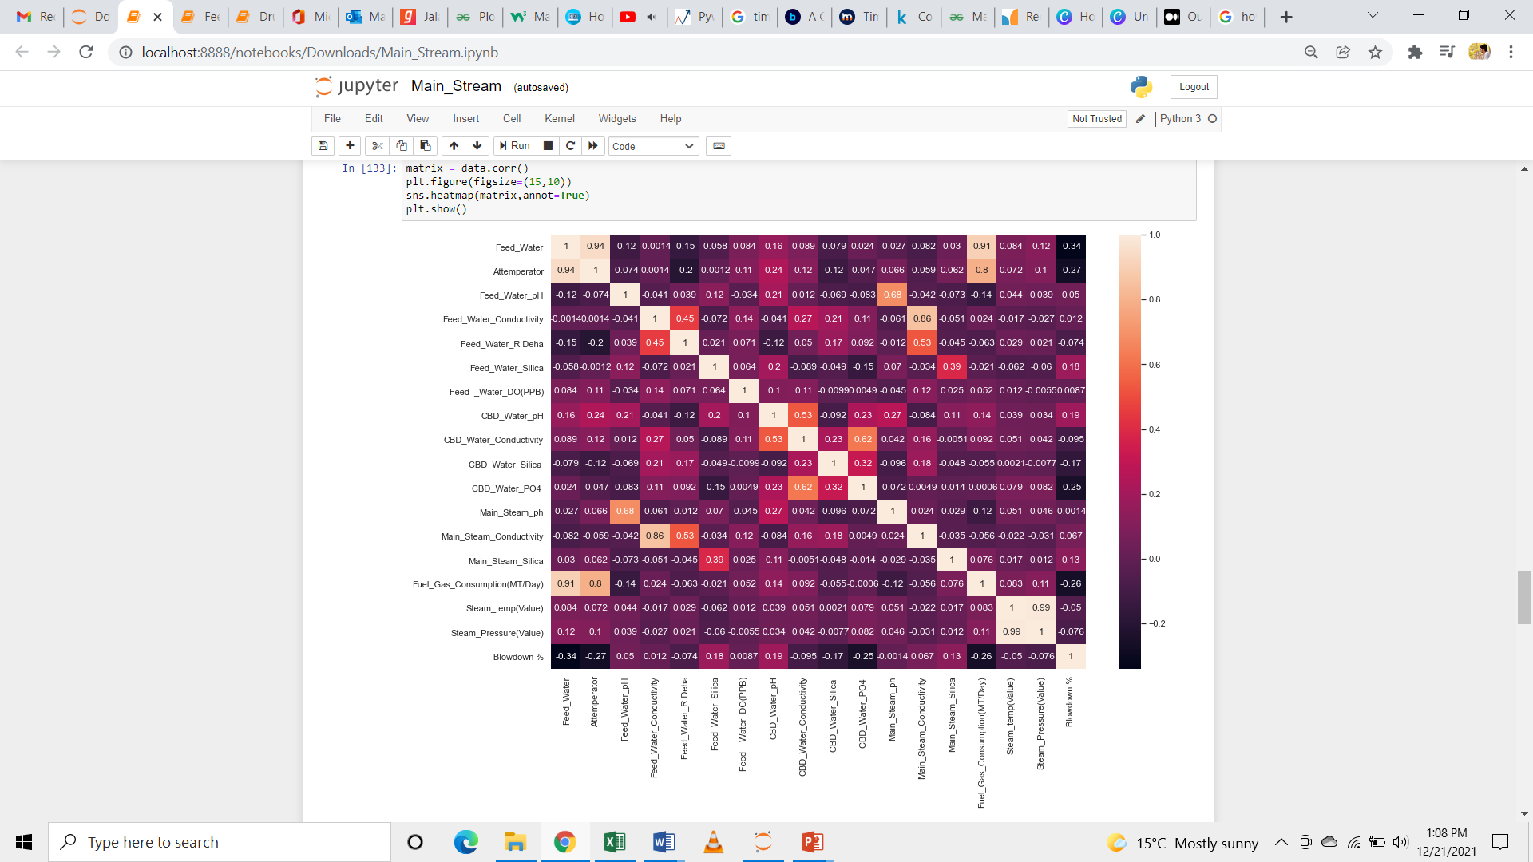
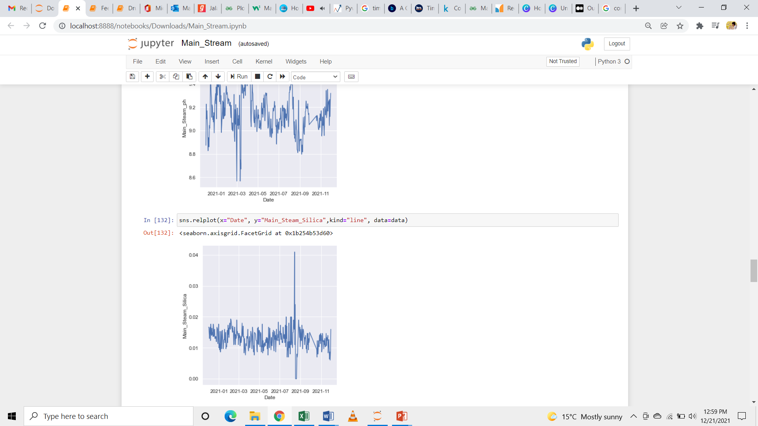
Main Steam EDA – Bi Variate Analysis
Feed water and Attemperator variable high positive correlation(0.94).
Main steam silica and feed water silica positively correlation(0.39)
There is a peak in Silica value on 14th Aug 2020 – 0.04

Slide 14
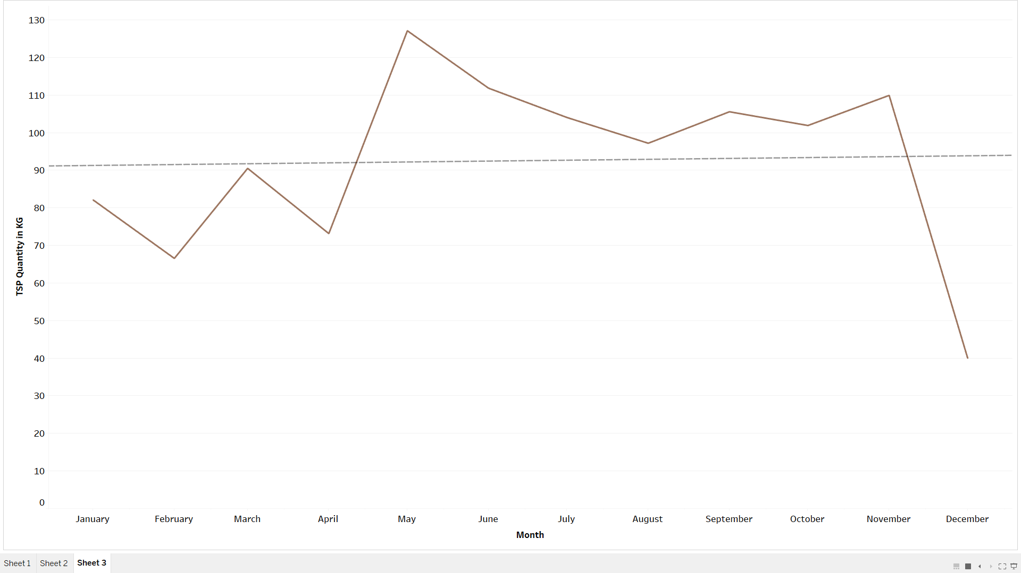
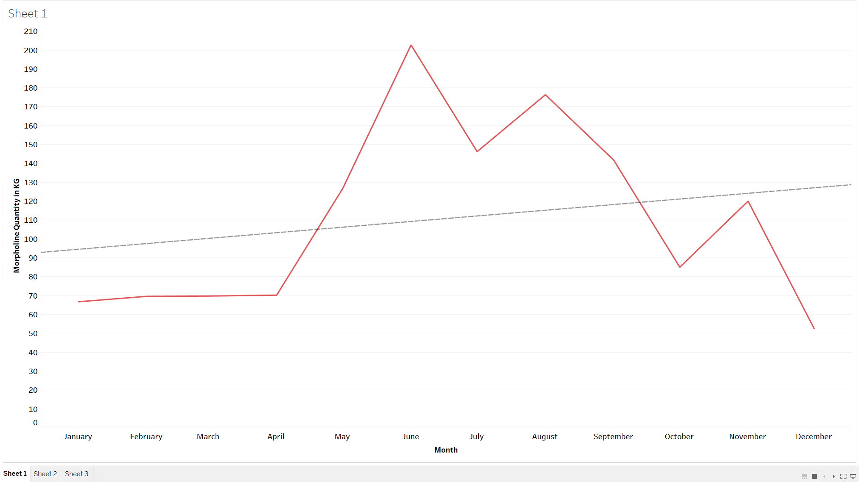
Chemical compounds
Heavy usage of Morpholine dosage (May – August)
Heavy usage of TSP dosage
(April – November)

Slide 15
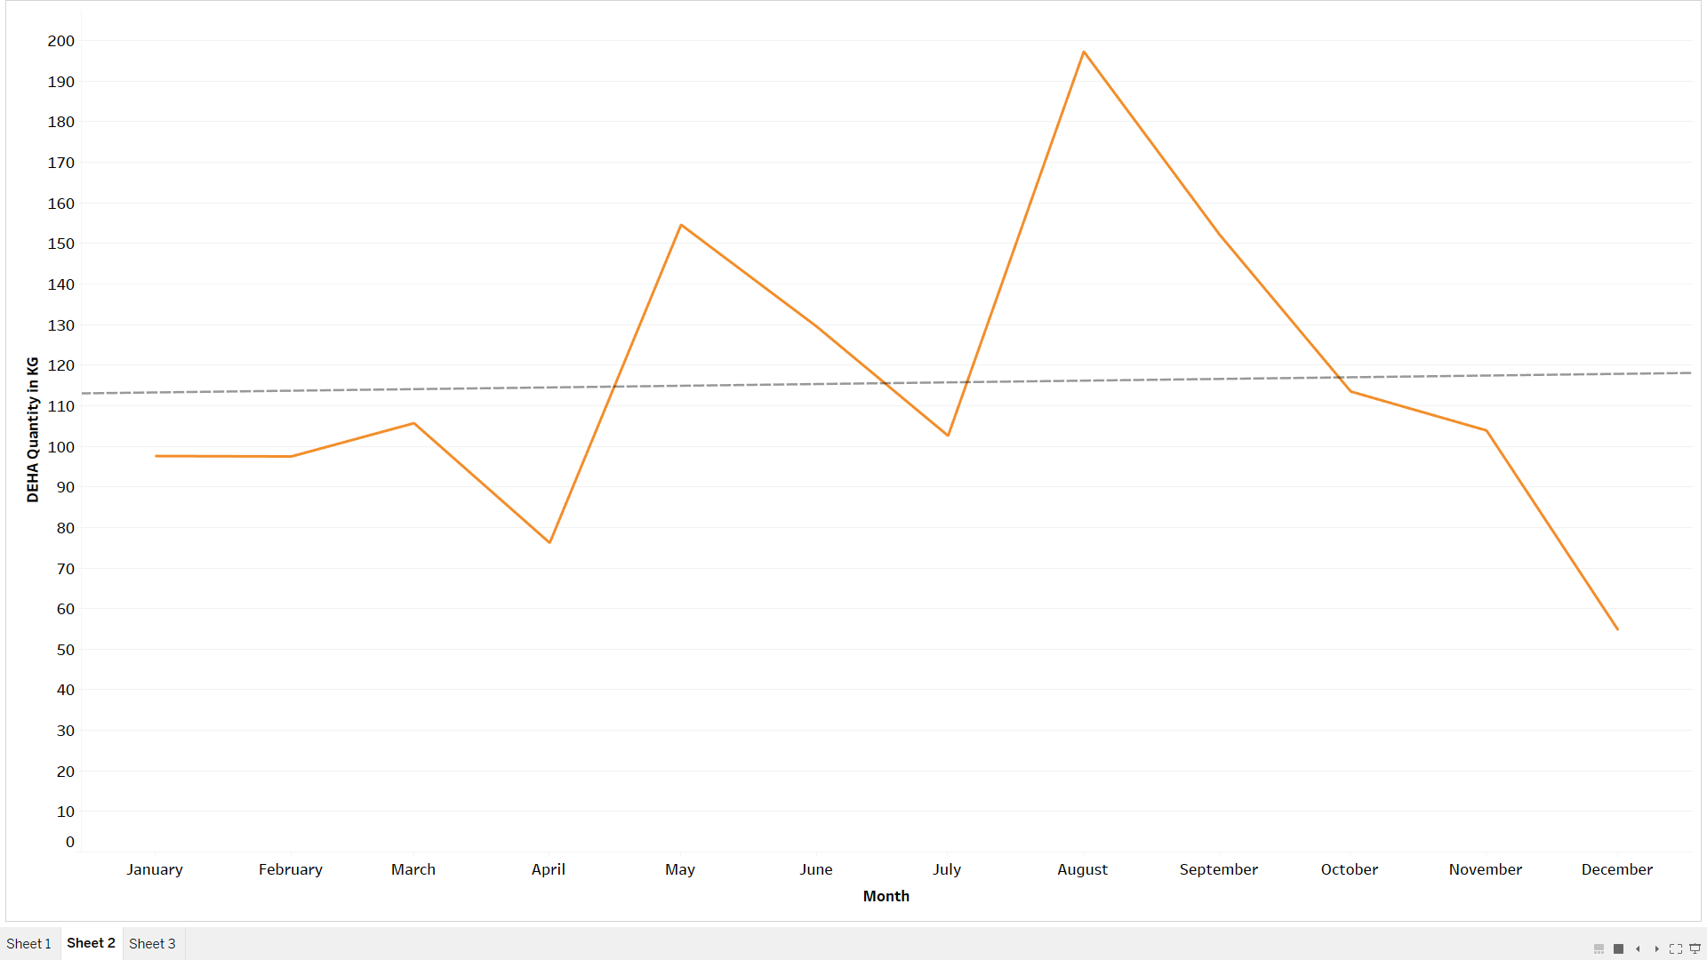
Chemical compounds
Heavy usage of DEHA dosage (April – October)

Slide 16
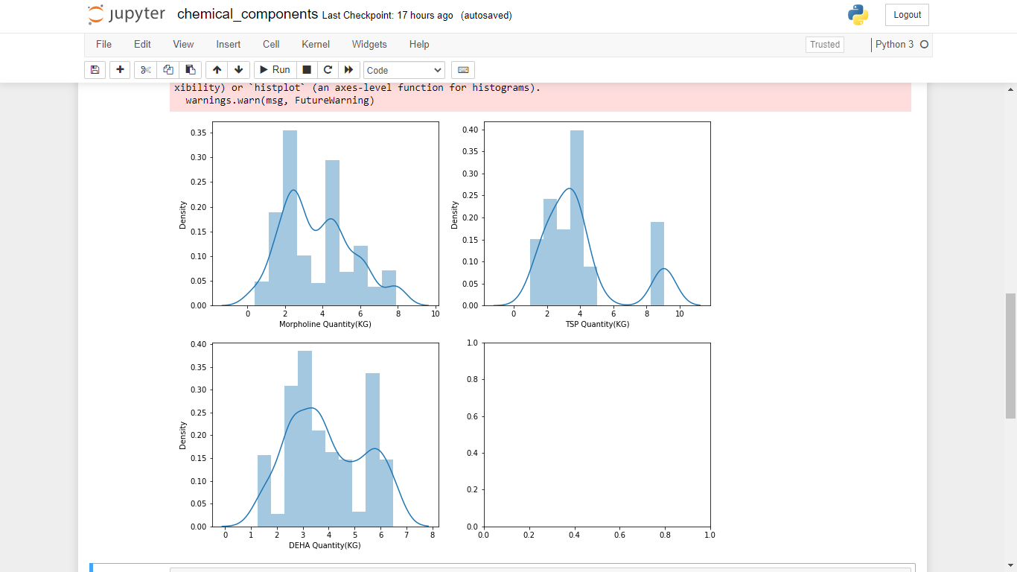
Chemical compounds
There is no proper Measure for Chemical Dosage at specified interval

Slide 17
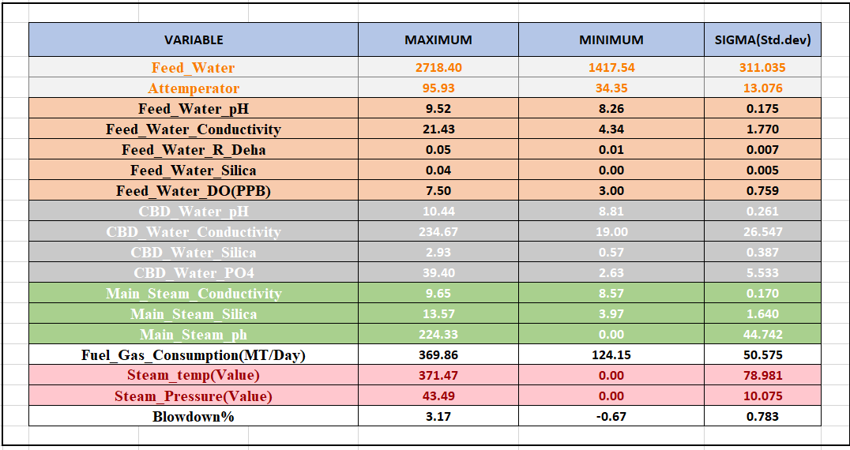
Uni – Variate Table for all the parameters
Outlier to be identified

Slide 18
Next steps
Baseline the Boiler efficiency by capturing quality parameter deviation Vs Chemical Dosage consumption - due to time delay
Baseline the Boiler efficiency by capturing quality parameter deviations Vs Blow down %
Measuring Chemical dosage savings against the quality parameter optimization [Remedy at right time]
Measuring Blow-down % savings against the quality parameter optimization at right time

